Slide 1

GitHubStats
SOFE3700 - Data Management Systems
GROUP 23
100601514 - Anna Safonov
100591742 - Umar Qureshi
100653360 - Pranjal Saloni
100670614 - Priyadharshini Ramalingam

Slide 2
GitHubStats
GitHubStats is a convenient web tool to peek at the current GitHub activity in a specific geographic region.
For this demonstration, we looked at the public users located in ON, Canada.
GitHubStats quantifies activity based on repositories owned by the users, as well as issues, pull requests and commit activity associated with those repositories.
Notes:
Priya

Slide 3
GitHubStats
In essence, this is a database web application that:
Queries, stores, analyzes and renders current GitHub stats on users, repositories, PRs, issues and commits
Uses GitHub REST API v3
A convenient way of looking at real-time commit statistics across repositories
Flexible tool that can be adapted to analyze and visualize GitHub information for many different projects
Notes:
Priya

Slide 4
Intro to GitHub 101
Most popular version control and project management platform
Provides general stats on individual repository pages
Issues, pull request, languages, contributors etc.
GUI and command line interfaces available
Built-in project management tools
Great platform for open source contribution
Github API is a set of services and methods to work with the platform
Github is built on top of Git which is an open source tool for tracking changes
Notes:
Pranjal

Slide 5

GitHub API
REST API v3
Public REST API
Works with a wide range of programming languages: Clojure, Erlang, Go, Java, JS, Perl, PHP, Python, Ruby, etc
Provides extensive documentation and guides for developers
Great open source community
Notes:
Umar
Provides endpoints for public, no access needed to to query from database

Slide 6





Technologies
GitHub API (JSON over REST API)
AWS
WAMP/XAMPP
MySQL/MySQL Workbench
Chart.js
Sublime
Bootstrap
Notes:
Anna

Slide 7
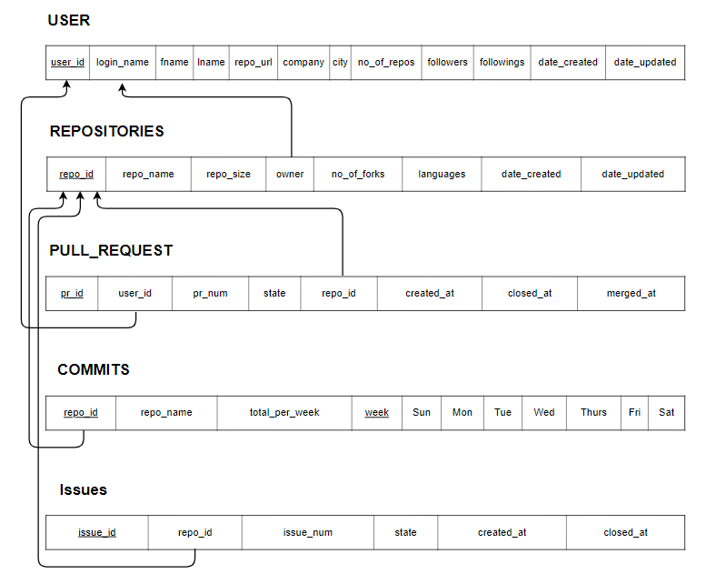
Relational Schema
Notes:
Umar

Slide 8
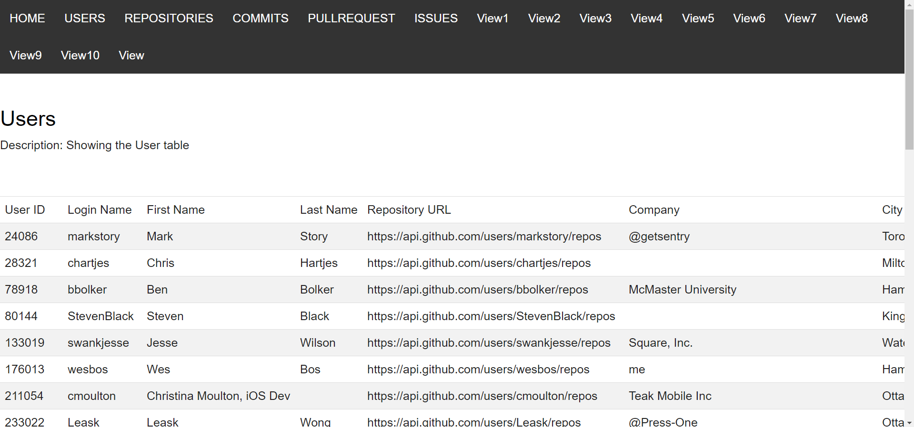

Slide 9
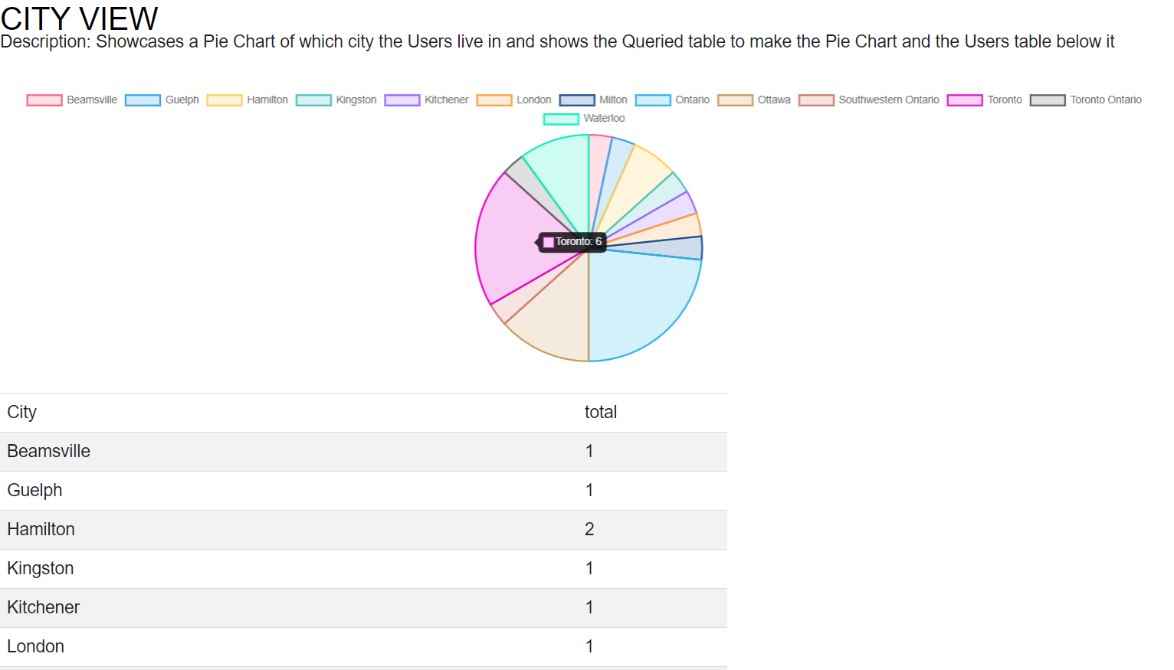

Slide 10
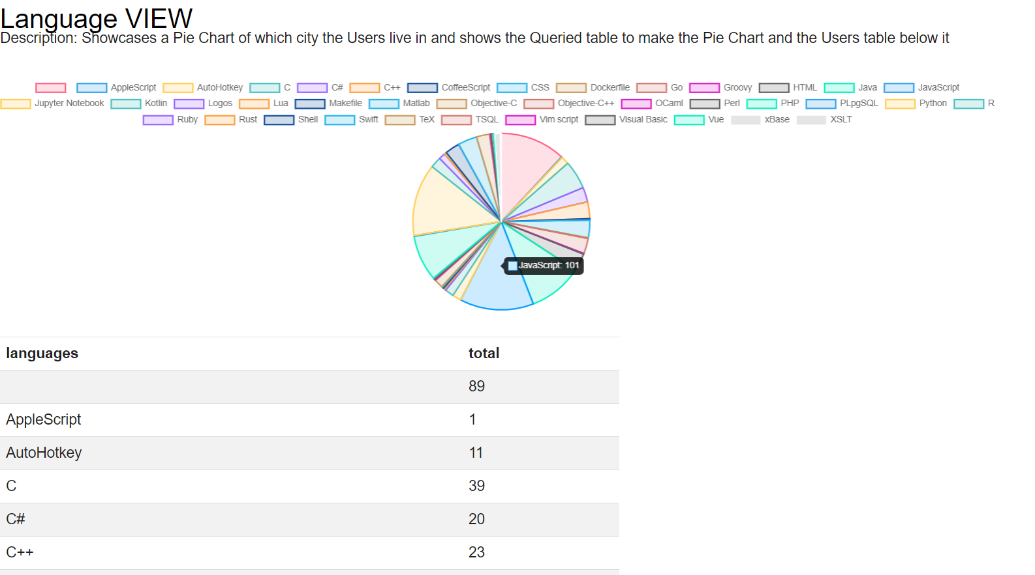

Slide 11
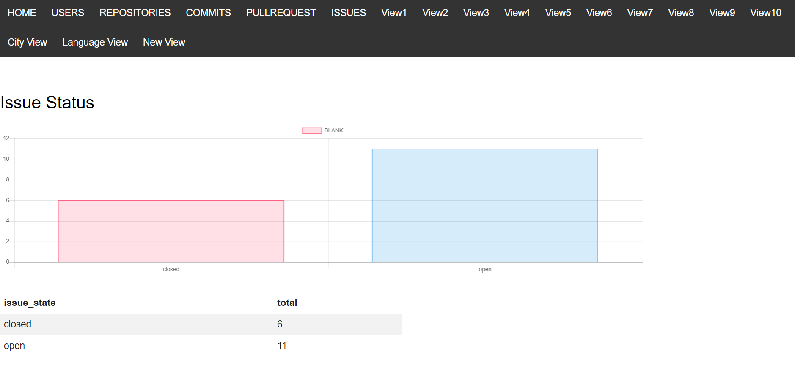

Slide 12
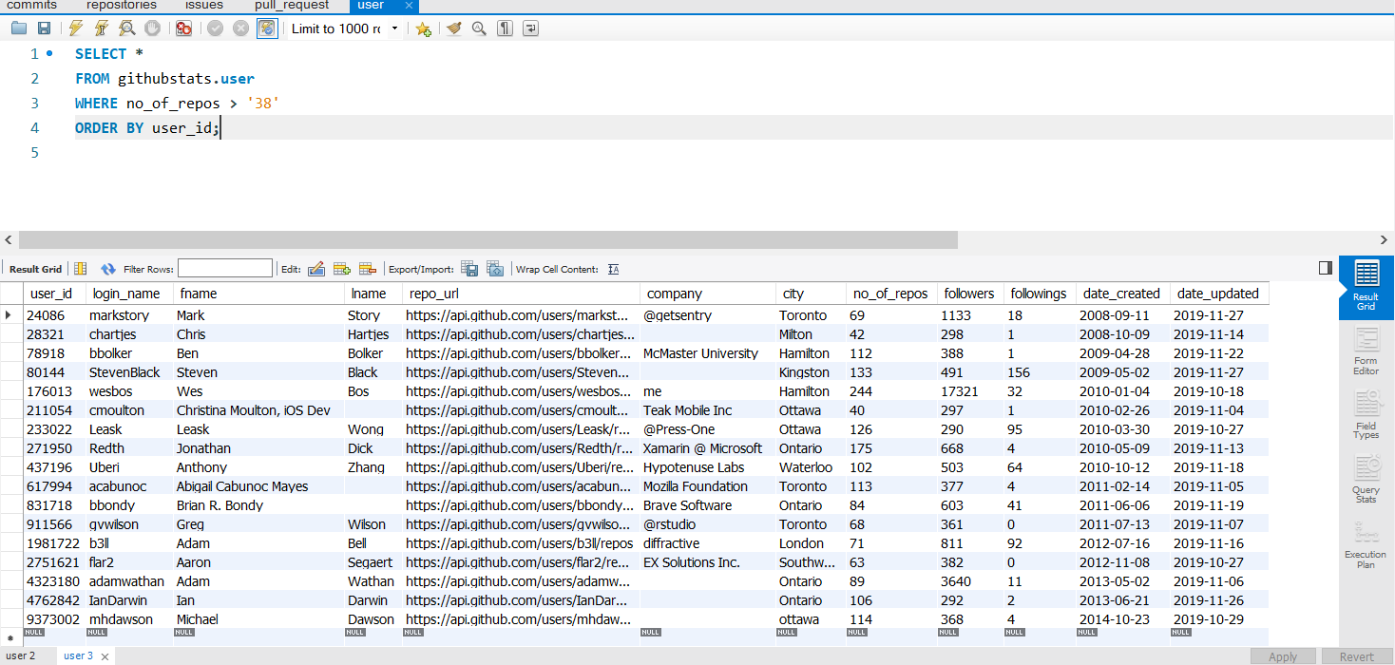
Views
All Users with More than 38 repositories)
Notes:
priya

Slide 13

GitHubStats Structure
Request JSON from GitHub API
Render queries to DB in the browser with HTML/CSS
Return JSON , parse with PHP
Insert parsed fields into MySQL DB
Notes:
Umar

Slide 14
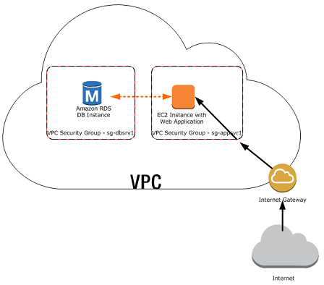
AWS Structure
Notes:
Anna

Slide 15
Future Directions
Adapt as a team management tool
Use for GitHub data analytics
Quantify team productivity on a project
Notes:
Anna

Slide 16
Thank You
Questions/Comments/Concerns?

